Slide 1
Sales Insights Project Report
NEEL BHOSALE

Slide 2
Hello Everyone, this is my very first project of Business Analytics Internship assigned by The TripadaSoft Solutions.
The task was to create a Dashboard for any Dataset and gain insights and make report.
I have used Tableau Software to make dashboard. You can check it online on Tableau Online by clicking here.
This dashboard gives you the insights about sales and profit(Created 2 different Dashboards for each).

Slide 3
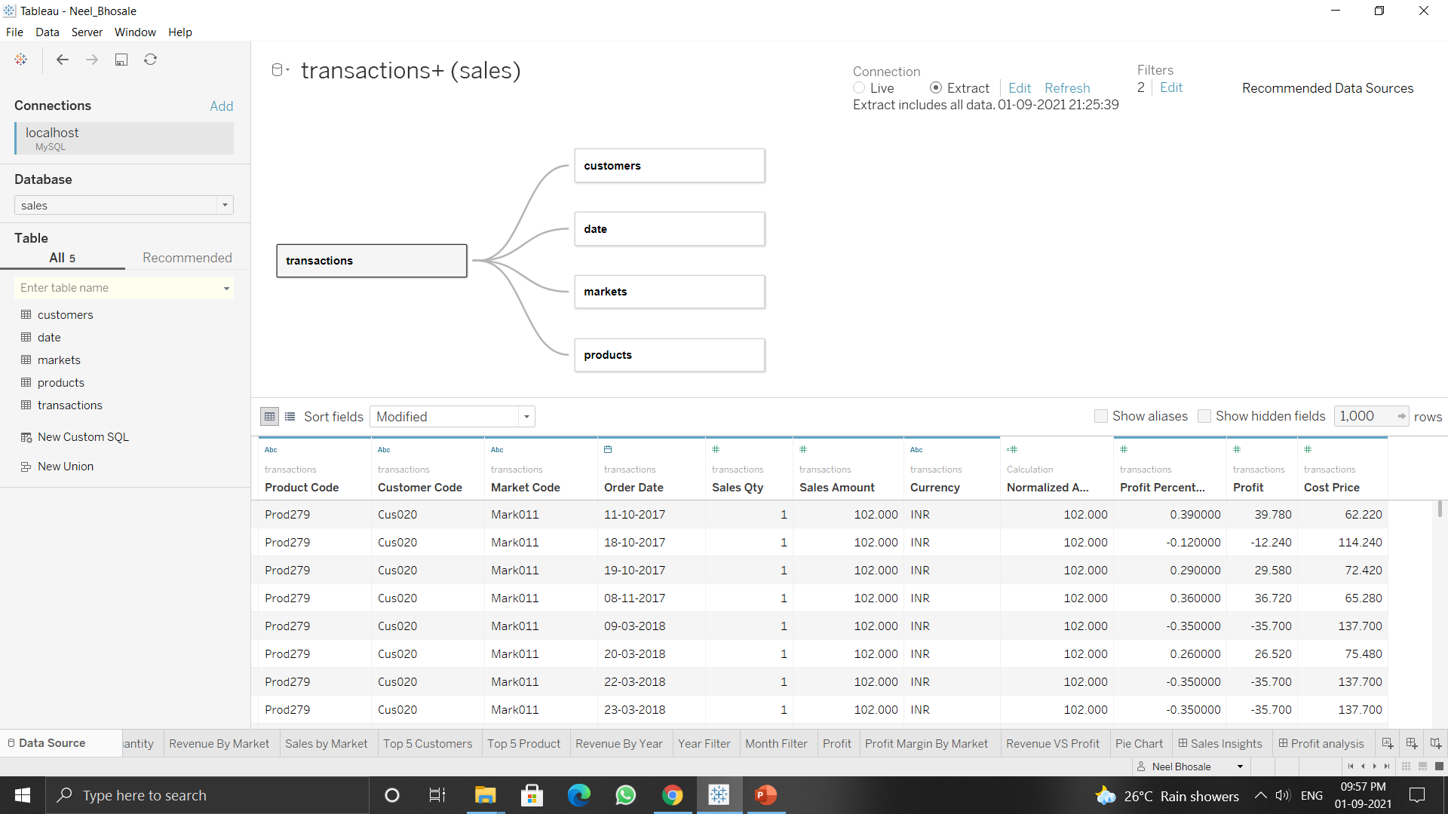
So this are my tables in .Sql file. I have transactions, customers, data, markets and products table in this file. The below figure shows the connection between all the different tables. It is a Star Schema. Here, the Normalized amount is the revenue of the sales if each product.

Slide 4
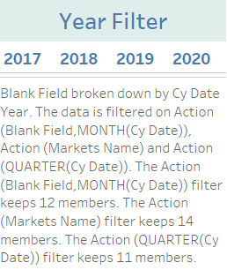
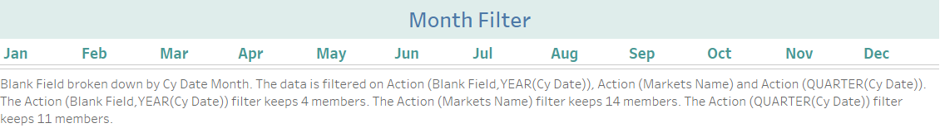
Both are the filters for the sales and profit dashboard's. This will give use exact data about revenue, profit and loss for each market and products in the dataset.

Slide 5
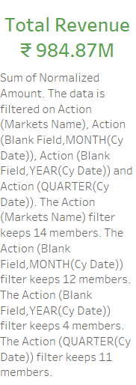
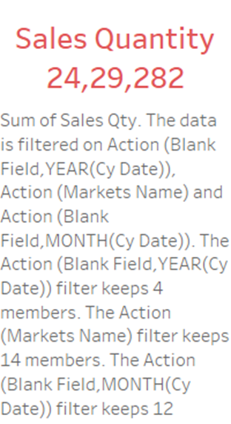
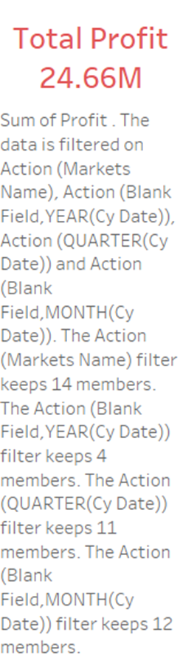
Below tables gives you the Total Revenue, Sales Quantity and Profit gained all over the year from 2017-2020

Slide 6
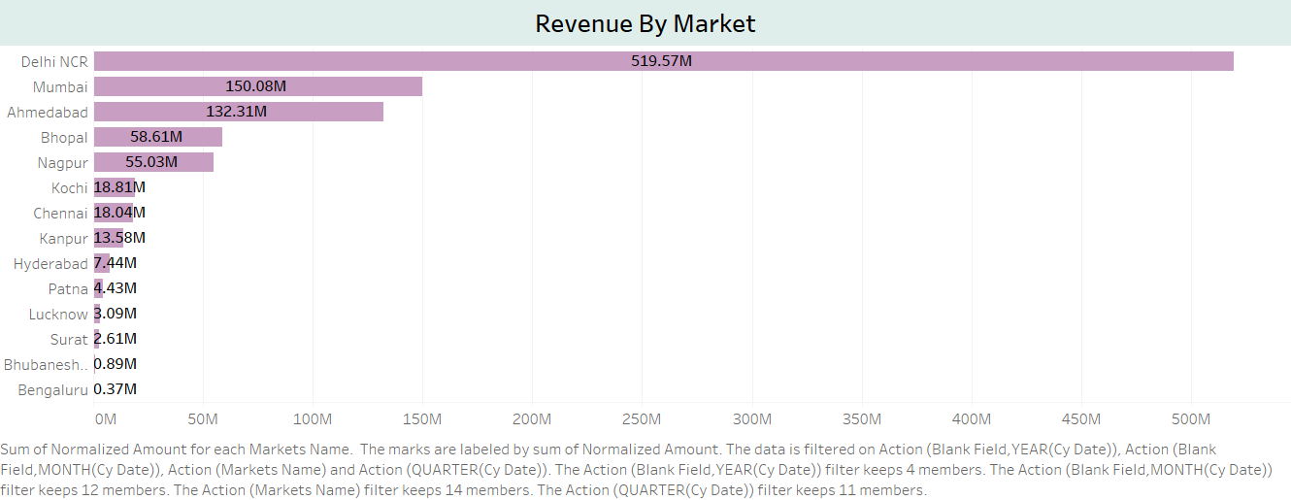
This is Revenue By Markets sheet. We can see that Delhi NCR has the highest revenue about 519.57M and Bengaluru has the lowest revenue i.e. 0.37M. Top 3 cities for highest revenue is Delhi, Mumbai and Ahmedabad. So we can invest more in this cities.

Slide 7
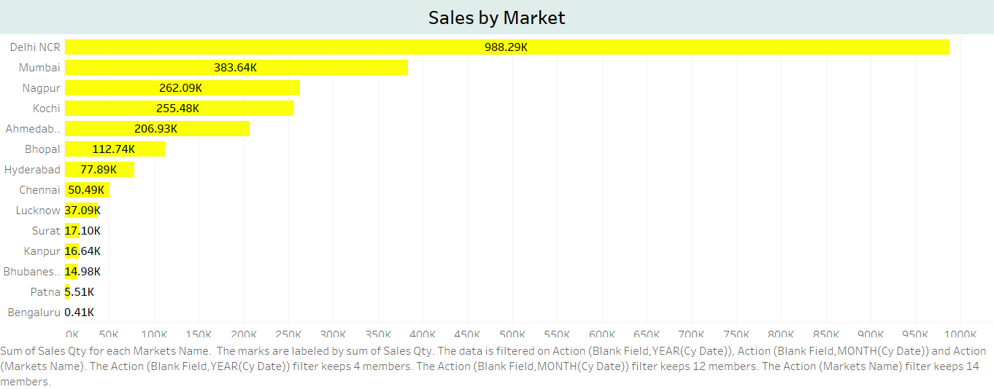
This is Sales By Market sheet, in this sheet we gain insights about sales are therein different Markets.
First we see, Delhi has highest revenue as well as in Sales and on other side Bengaluru has lowest sales as well as revenue. Top 3 cities for selling products are Delhi NCR, Mumbai and Nagpur. We should add some discounts in the lower cities such as Patna, Bengaluru, Kanpur etc to gain more sales in that area.

Slide 8
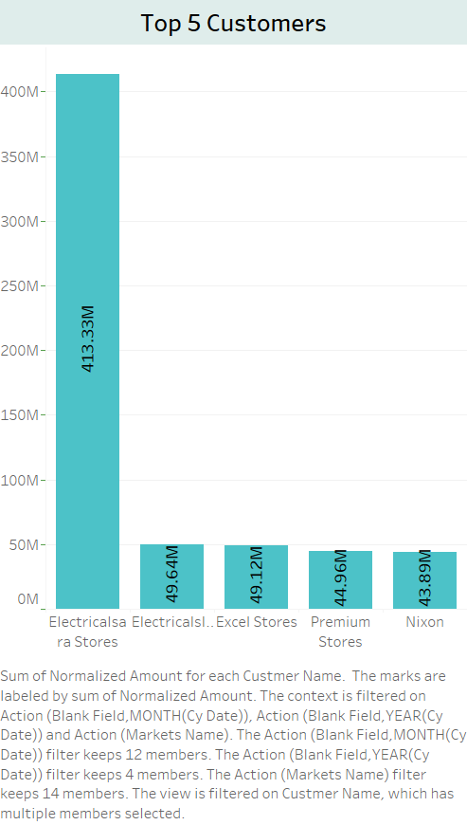
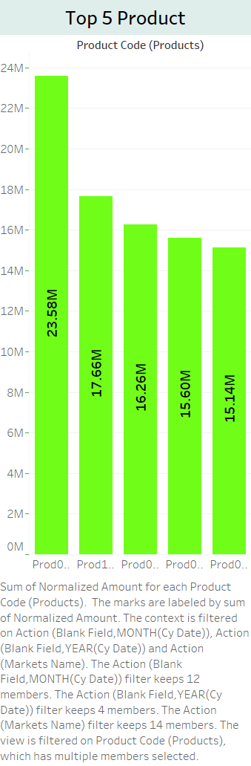
In the both sheets, we can see Top 5 Customers And Products which gives you the highest revenue in the sales.
As we can see in top Customer are from Electricalsara Stores and on the right side i.e. Top 5 products we can see the product code of the products that gives us the highest revenue.

Slide 9
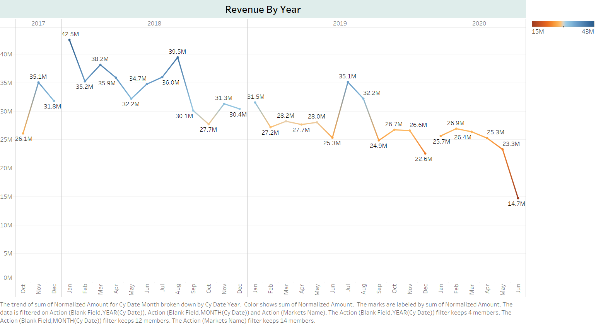
This is Revenue By Year sheet. In this we can see the revenue by year per month.
Highest revenue is in the year 2018 int the month of JAN i.e. 42.5M and average revenue is in the year 2017 and 2019. We can see, the revenue is fallen in the year 2020 to 14.7M. We have to look into.

Slide 10
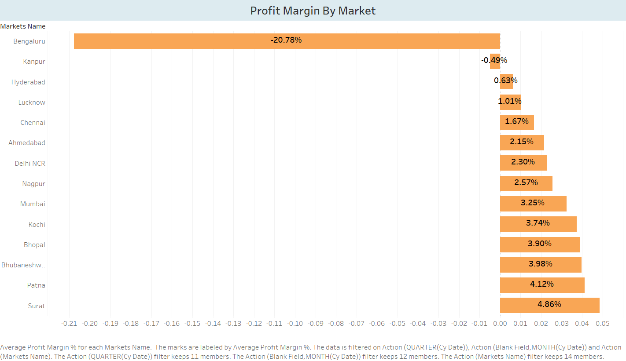
This is Profit Margin By Market. In this we get the profit of each sales in market in percentage.
We can see that Bengaluru has the negative profit margin in the whole market and behind that Kanpur city. We can see that Surat, Patna and Bhubaneshwar gives you the highest profit in the whole market and other cities have average profit.

Slide 11
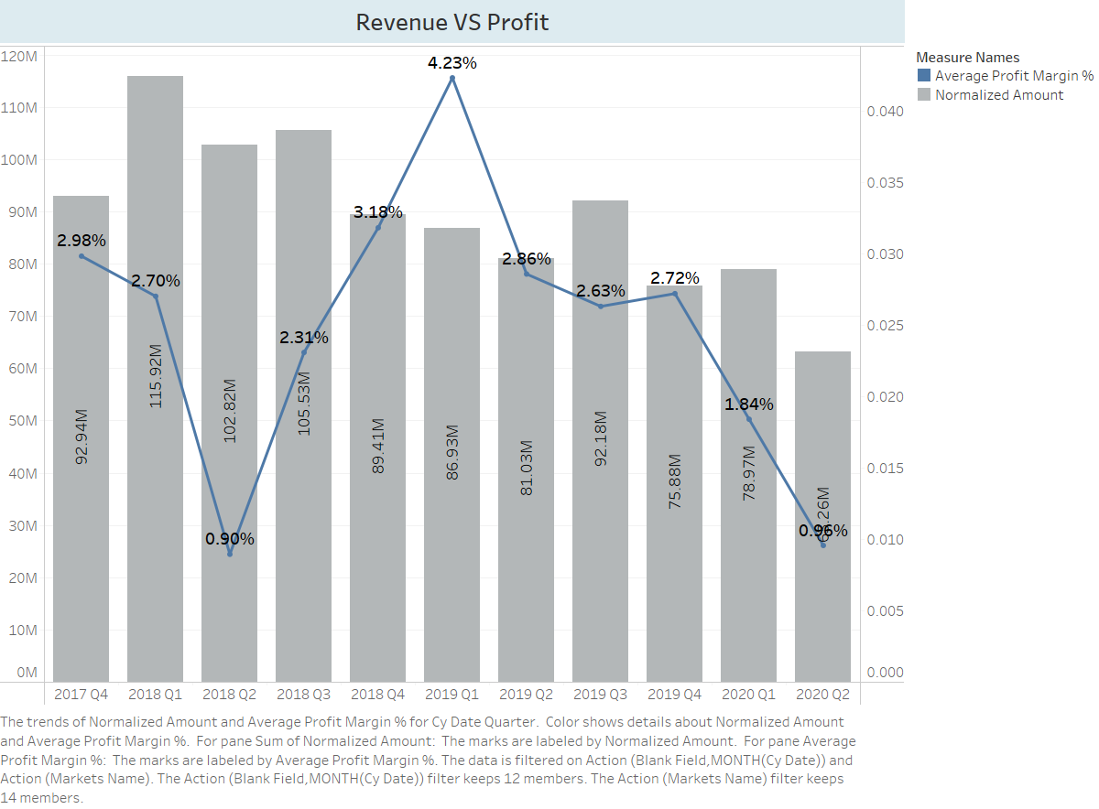
In this sheet, we can see Revenue VS Profit in Sales.
We can see the revenue was highest in the year 2018 in Q1, Q2 and Q3 i.e. 100M+ and profit in that particular quarter was low on other hand we see the revenue in 2018 Q1 & 2019 Q1, we have the highest profit as compared other. 4.23% is highest profit and lowest is 0.96 in 2020 Q2.

Slide 12
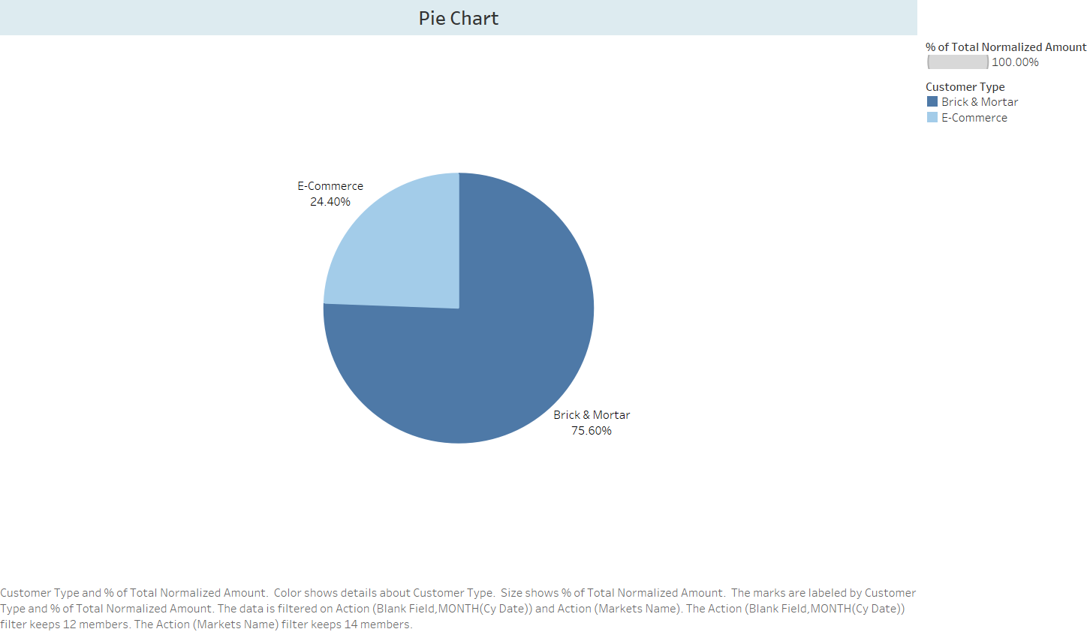
This is Pie Chart For Customer Type And Their Revenue.
We get to see that Brick and Mortar customers gives us highest sales about 75.60% as compared to E- Commerce i.e. 24.40%. We can conclude that we should invest in Brick and Mortar and make some offers in E-Commerce side.

Slide 13
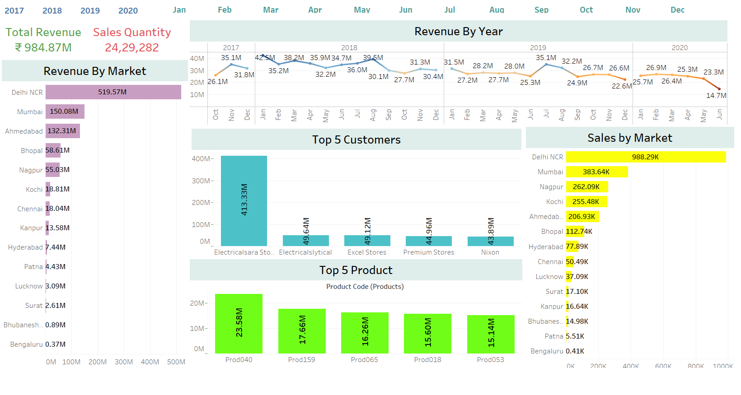
SALES INSIGHTS DASHBOARD

Slide 14
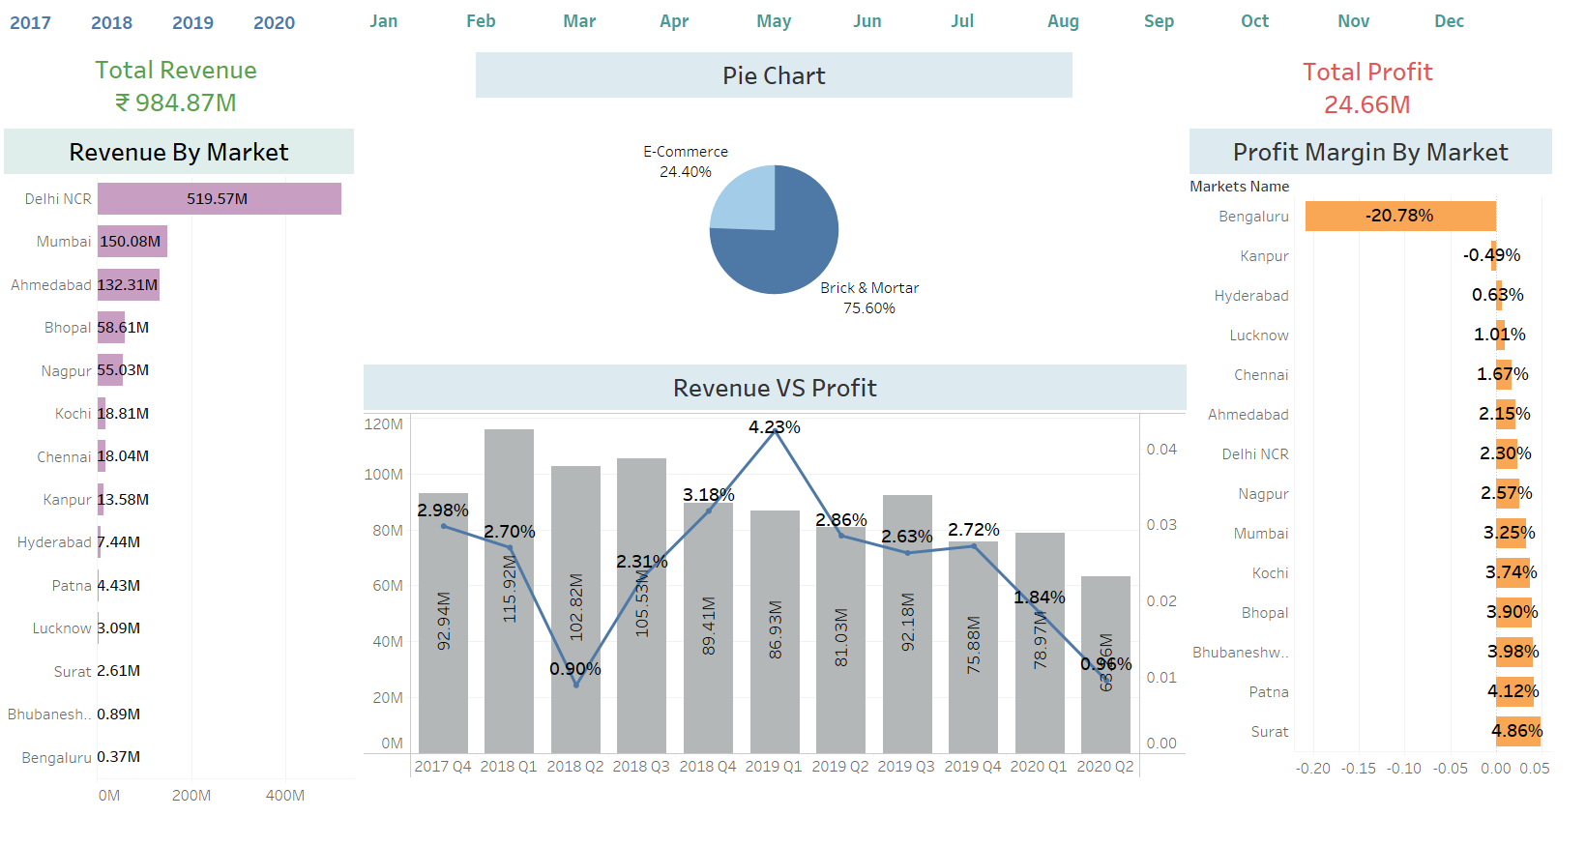
PROFIT ANALYSIS DASHBOARD

Slide 15
Conclusion
So we conclude the following points:
We can invest more in the Surat, Patna, Mumbai and Delhi as this cities gives us more sales, revenue and profit in all cases.
We should look out in Bengaluru, Bhubaneshwar and Kanpur cities as it gives us lowest profit, revenue and as well as sales.
To increase the profit in the market, we should give offers on products and give them better deal or else we should take feedback of customers what they dislike about our product in that area and workout on it.
We should increase the production in the top 5 cities which gives us profit and revenue in both terms.
We can ask for the feedback and make changes as they want and assure our best services.
As the revenue is fallen in year 2020, we should ask our team were it went wrong and make changes into it to increase revenue as well as profit.
We should increase the production and make it more better in the top 5 products all the time and in the particular cities.

Slide 16
THANK YOU
Feedback Appreciated
Neel Bhosale: LINKED PROFILE
Email: neelbhosale5538@gmail.com

